Slide 1

Southwest Asia’s
Ethnic Groups
Arabs, Kurds, & Persians

Slide 2
Standards
SS7G8 The student will describe the diverse cultures of the people who live in Southwest Asia (Middle East).
b. Explain the diversity of religions within the Arabs, Persians, and Kurds.

Slide 3


Slide 4
Southwest Asia’s
Ethnic Groups
Arabs, Kurds, & Persians

Slide 5
Ethnic Groups
This is a group of people who share a common culture.
  These characteristics have been part of their community for generations.
Ethnic groups can have many things in common:
  Shared history, common ancestry, language, religion, traditions, beliefs, holidays, food, etc.
All of these things make up a common culture that is shared by the members of the ethnic group.

Slide 6
Religious Groups
This is a group of people who share a belief system. They believe in the same god (or gods) and have common sacred text with a specific set of rules about how to live.
Religious groups have many things in common:
  God(s), prophets, prayers, history, sacred text, religious laws, holy days, etc.
People from different ethnic groups may share the same religion; however, they may be from different cultures.

Slide 7
Arabs

Slide 8
Arabs – Location
Arabs comprise most of the population of Southwest Asia.
Arabs also live in the United States, Canada, parts of northern Africa, and Europe.

Slide 9
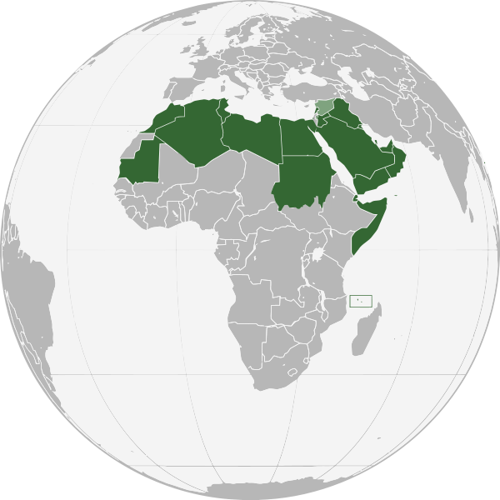

Slide 10
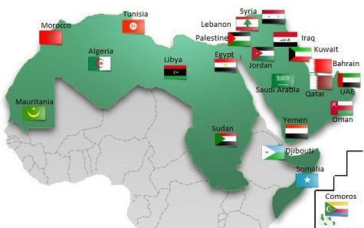

Slide 11
Arabs – Ancestry
Arabs of Southwest Asia believe themselves to be descendants of Abraham through his son Ishmael.
Arabs make up the majority of the people who live throughout the Middle East.

Slide 12
Arabs – Religion
Most Arabs practice Islam.
  Small numbers of Arabs practice other religions.
  Not all Arabs are Muslims, and not all Muslims are Arabs.
Islam consists mostly of two different groups. The majority of Muslims practice Sunni Islam. Most others practice Shi’a Islam.
  Sunnis and Shi’a disagree about who is in charge of the Muslim world.
Small numbers of Arabs practice other religions. Some Arabs are Christians.

Slide 13
Arabs – Language
Most Arabs, whether they are Muslim or Christian, speak Arabic.

Slide 14
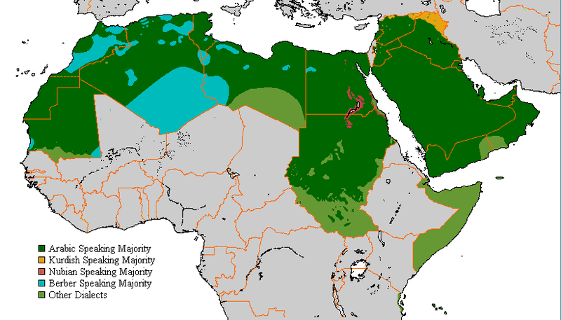

Slide 15
Kurds

Slide 16
Kurds – Location
The Kurds are an ethnic group that live in Turkey, Syria, Iraq, and Iran.
  Kurds form almost 20% of the population of Turkey and Iraq.
  Many Kurds live in an area of northern Iraq called Kurdistan (not a separate country).
They are the largest ethnic group in the world without a country of their own.
  Many Kurds hope to have a nation of their own some day.
  This has caused conflict with the countries in which Kurdish people live.

Slide 17
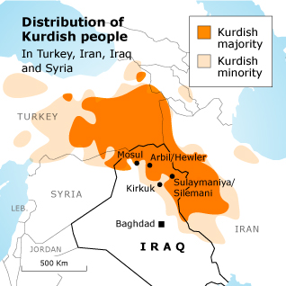

Slide 18
Kurds – Ancestry
Kurds of Southwest Asia believe themselves to be descendants of the Medes, an ancient Iranian people.
  In fact, Kurds share many aspects of their culture with Iranians.

Slide 19
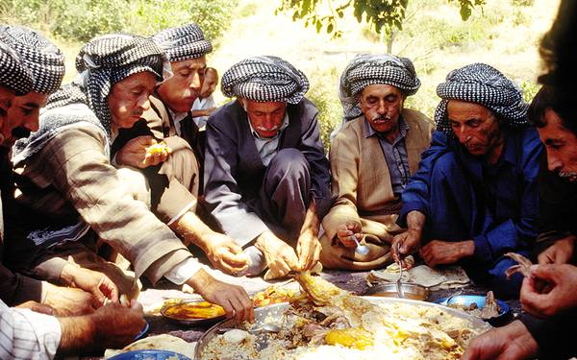

Slide 20
Kurds – Religion
Like the Arabs, the Kurds are overwhelmingly Muslim
Kurdish Muslims tend to be less strict about certain Islamic practices.
  For example, there are fewer laws for how Kurdish women should dress than there are for Iranian and Arab women.

Slide 21
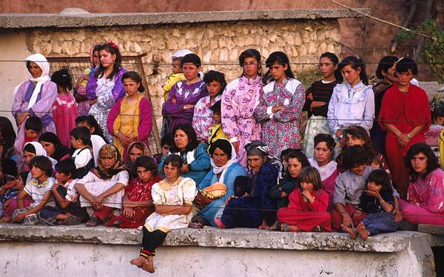

Slide 22
Kurds – Language
Kurdish is an Indo-European language related to Farsi (Persian) and other Iranian languages.
There are many different dialects of Kurdish spoken throughout Southwest Asia.

Slide 23
Persians

Slide 24
Persians – Location
Persians are those who live in the modern country of Iran.
  They make up about half of Iran’s current population.
  The country of Persia became known as Iran in 1935.
  There is written evidence (cuneiform) that was found in Iran that proves that “Persia” was the name of this area since its beginning.
Today, Persians can be found living in Afghanistan, Tajikistan, Uzbekistan, Pakistan, and the Xinjiang province of China.

Slide 25
Persians – Ancestry
The Persians lived in Iran before the arrival of Islam in the 7th century.
The Persians’ ancestors were Indo-Europeans who migrated from central Europe and Southern Russia and formed a great empire.

Slide 26
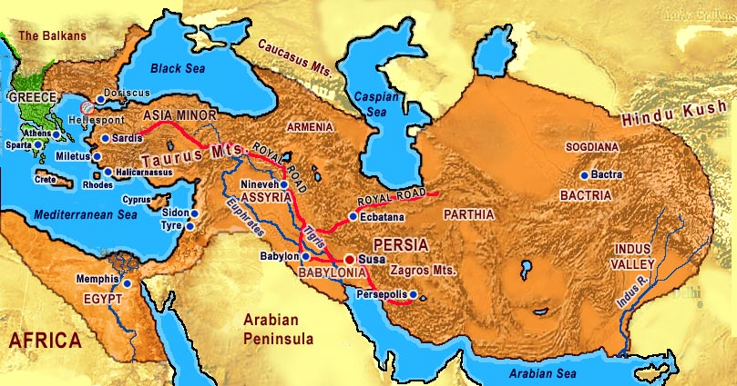
Persian Empire

Slide 27
Persians – Religion
Most Persians in Iran practice Islam, but some are other religions.
Persian women have faced many challenges as a result of strict cultural and religious practices.

Slide 28
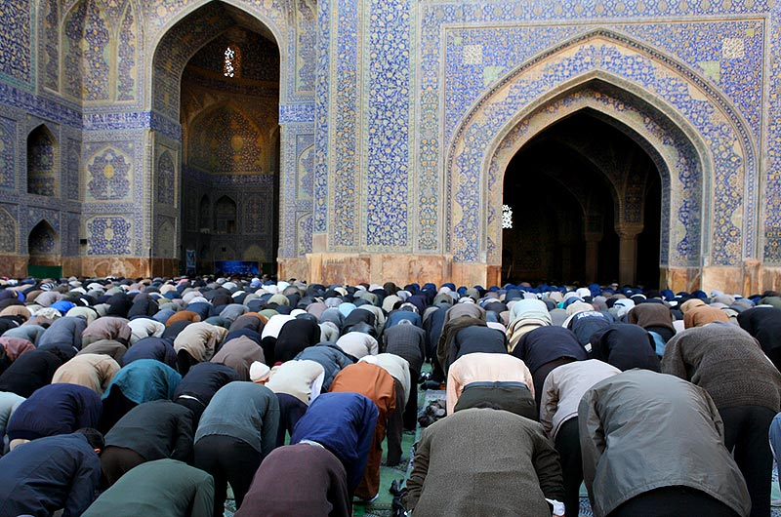

Slide 29
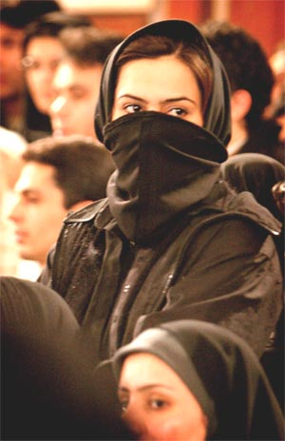
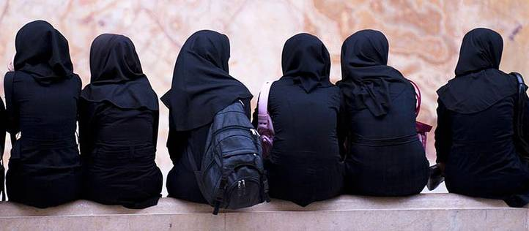

Slide 30
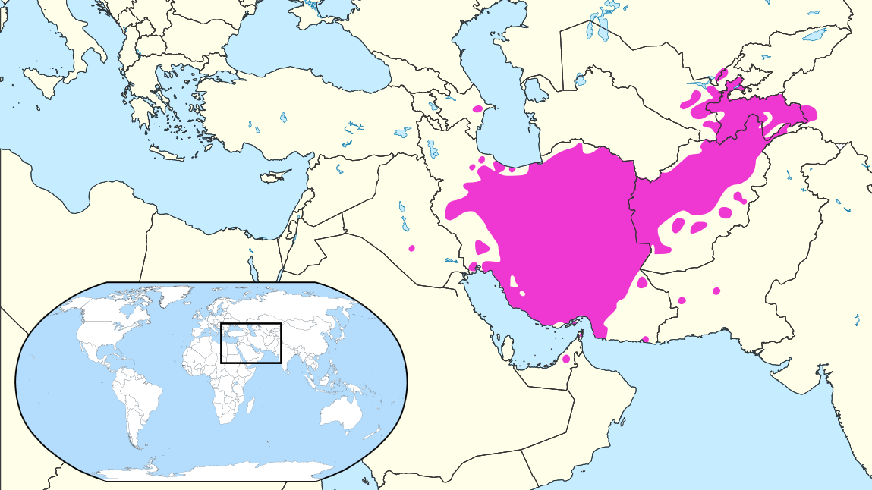
Persians – Language
Persians speak a language called Farsi (or Persian).
  It is one of the oldest languages that is still spoken today!
Where Farsi is Spoken Today…

